Slide 1
Recruiting and Training a High Performing Board
Abbie J. von Schlegell, CFRE
a. von schlegell & co
January 23, 2018

Slide 2
The Difference Between “Responsible” and “Exceptional” Boards
BoardSource

Slide 3
“Responsible” Boards
Capable and dutiful in carrying out its responsibilities
Understands its fiduciary obligations
Approves strategic plans and budgets
Regularly reviews financial statements
Evaluates the chief executive annually
Participates in fundraising

Slide 4
“Exceptional” Boards
Operate on a higher level -- “more” and “different”
Members give more and differently:
Time spent more wisely
Skills, assets and social networks better leveraged and more strategically deployed.
Measure organizational impact
Evaluate their own performance
Discuss and debate issues
Engage in strategic and generative work
Open doors and make strategic connections.

Slide 5
3 Modes of Governance
Fiduciary Mode -- key questions
"How are we doing to date?"
“Are we in compliance?”
Anything wrong?
Strategic Mode -- key questions
"What should we be doing?”
"Where are we going?“
What’s the plan?
Generative Mode -- key questions
“What are the new possibilities?”
“What’s coming next?”
What’s the new question?

Slide 6
Visionary Board Leadership
Visionary and future-focused
Entrepreneurial spirit
Risk-takers
Strategic decision makers
Effective communicators
Systems thinkers
Partnership and alliance builders
Diverse

Slide 7
An Effective Recruitment and Training System
Key Features and Characteristics

Slide 8
Key Features and Characteristics
Formal ongoing board development process
Process in place to identify and develop future leaders
Rotation of committee assignments
Board reflects full spectrum of constituencies
Diverse in terms of critical demographic factors
Continuing plan to maintain diversity
Board size supports effective governance
Comprehensive orientation for all new members
All board members receive training

Slide 9
Markers of Effective Recruitment and Training
The Governance Committee
Board development as on-going leadership development
Clearly defined roles and responsibilities
Recruitment and training aligned with strategic plan
Balancing diversity and commonality

Slide 10
The Governance Committee
Leading the Effort

Slide 11
Board Governance Committee
Continuous focus on identifying, preparing and recruiting future board leaders
Plan board education including new member orientation, ongoing training and board retreats
Assess board, chair, individual directors, and board meetings
Annually review governance practices and recommend changes

Slide 12
A Leadership Development Process
Nominations and recruitment -- identifying the right individuals to meet the needs of the board, helping them understand their roles and responsibilities, and inviting them to join your board
Orientation -- giving new board directors information they need to carry out their roles and responsibilities effectively
Training -- regular, ongoing efforts to build new skills and knowledge among the existing board directors to enhance performance

Slide 13
A Leadership Development Process
Evaluation -- annual task of evaluating individual board director performance as well as the effectiveness of the board as a whole and individually
Recognition -- ongoing process of recognizing the work and accomplishments of board directors to the work of the board and to the organization.

Slide 14
Clearly Defined Roles & Responsibilities

Slide 15
Clearly Defined Roles & Responsibilities
Clarity re: management and governance
Maintain clarity re: board policy and oversight functions
Written individual board and committee descriptions that are current
Board manual prepared for all board members

Slide 16
Board Member Job Description
Attend all regular board meetings.
Serve as an active committee member.
Participate in fund development activities
Support public policy agenda/initiatives.
Prepare in advance for board policy and decision-making.
Attend the annual board planning retreat.

Slide 17
Diversity in Recruitment
Diversity in demographics
Diversity in linkages to different communities and groups
Diversity in expertise
Diversity in thinking

Slide 18
Commonality in Recruitment
In board members’ belief in the organization’s mission and core values
In board members’ depth of commitment
In terms of focus on strategic work of the board

Slide 19
Steps of the Recruitment Process

Slide 20
Recruitment Process
Step 1. Establish a Board Governance Committee
Step 2. Prepare for Active Board Director Recruitment
Step 3. Develop a Profile of the Current Board Leading to Recruiting Priorities

Slide 21
Recruitment Process
Step 4. Develop initial list of prospective Board members
Step 5. First round of personal contact with top potential prospects
Step 6. Scheduling and conducting orientation sessions with prospective Board members
Step 7. Selection/Appointment of new members to the Board

Slide 22
Board Member | Year Group (s) | History | Museums/ Collections | Nonprofit Mgt. | Governance | Legal | Finance | Fund Development | Business Management | Insurance or Investments | Marketing/ Communications | Retail Sales | Education/ Programs Programs | Human Resources | Facilities Management | Information Technology | Community/ Local Govt.
A. Smith | 12 |  |  | X | X |  | X |  | X | X |  |  |  |  | X
B. Jones | 10 |  | X |  | X |  |  |  |  |  |  |  | X
C. White | 11 |  |  |  | X |  |  | X | X | X |  |  |  | X |  |  | X
Other names, etc. | 11 |  |  |  |  |  |  |  |  |  |  |  | X
 | 12 | X |  |  | X |  |  | X |  |  |  |  |  | X
 | 10 | X |  |  | X |  |  | X
 | 10 | X |  |  |  | X |  |  |  |  | X |  |  | X |  |  | X
 | 11 |  |  |  |  | X | X |  |  |  |  |  |  |  |  |  | X
 | 10 | X |  |  | X | X |  |  | X
 | 12 | X |  |  |  |  |  |  | X |  | X |  |  |  |  |  | X
 | 11 | X | X | X |  |  |  |  |  |  | X |  | X |  | X
 | 11 |  |  |  |  |  | X
 | 12 |  |  |  |  |  |  | X | X |  | X | X | X | X | X |  | X
 | 10 |  |  |  |  | X |  | X
Vacant | 12

Slide 23
Where Do We Find New Board Members?
The more specific the criteria, the easier to identify potential candidates.
Think outside the box, approach professional organizations
Look to people who have already shown an interest in the work of the organization
Organize events that are designed to introduce the work of the organization
Utilize board matching services

Slide 24
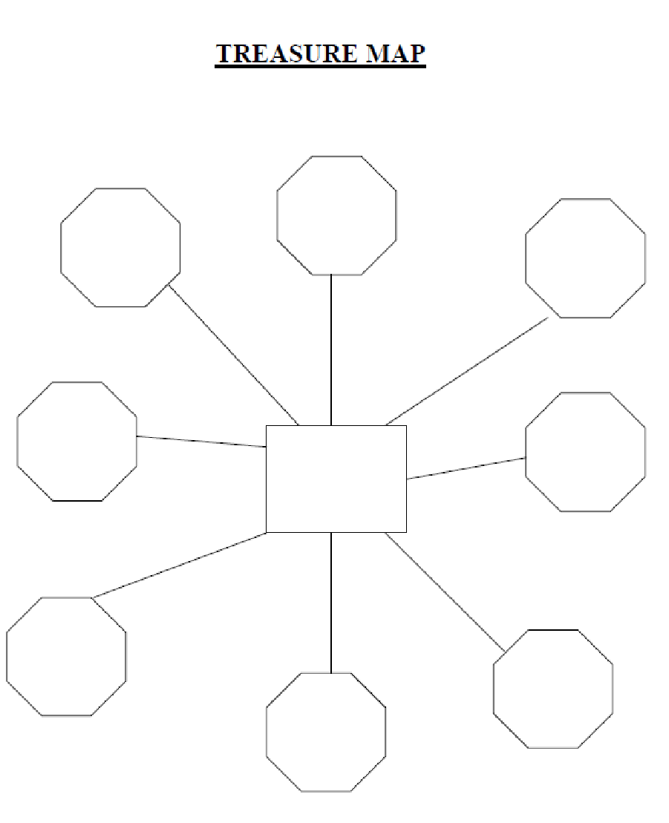

Slide 25
What Other Recruitment Tools and Techniques Have Worked for You?

Slide 26
Using a Blue Ribbon Nominating Task Force for Your Board
A method to recruit 3 to 5 new Board Members in the next Six Months

Slide 27
Steps of the Blue Ribbon Process
Identify about 25 potential Blue Ribbon Committee members.
Invite them to participate on the Blue Ribbon Nominating Committee.
Meeting once for one and a half hours
Free breakfast or lunch
At the meeting . . .
Brief update on organization’s “critical path”
Be clear on what you need board members to do
Ask each member to nominate 3 to 5 prospects

Slide 28
Steps of the Process
After the meeting . . .
Sift through the 10 = 20 nominations received
Select the first names to call
Make the calls
“Emily, I’m calling because Sally Carlson suggested you for our Board of Directors…”
Face-to-face meetings with interested individuals

Slide 29
Building on the Results
New board members ready to bring onto the board now or in the future
Leadership contacts for committees, workgroups and special projects
Deepened relationships with the connectors in your community
Building a foundation for your board leader talent pipeline
Convene new Blue Ribbon Nominating Committees when needed

Slide 30
Board Training and Orientation

Slide 31
Engaging New Members
New members must be welcomed and oriented to its culture
Provide each new board members with a clear roles and assignments
Bring new board members into the board conversation
Provide board mentors as option
Check in periodically with new board members.

Slide 32
Board Orientation & Training Timetable
During The Recruitment Stage (Before election or appointment)
New Member Orientation (Immediately upon the election or appointment)
Early Service (During the first three months of the new board directors’ tenure):
Ongoing Training (Training and support on an ongoing basis for current and new board directors)

Slide 33
Orientation Purpose
Three intertwining objectives:
Inform new Board members about the organization and its programs
Communicate performance expectations for board members
Engage new members into the Board’s work as quickly as possible
Notes:
Orientation
Orientation and training have two intertwining objectives:
To inform Board members about the organization and its programs
To integrate new members into the Board as quickly as possible
An orientation session should be scheduled with new members between the time they begin their service to the Board and the first Board of Directors meeting in which they are scheduled to participate.
Some amount of “informal” orientation will naturally occur, but it can be encouraged by other Board members. During the first few months of a new member’s term, the staff and Board should be sensitive to new members’ need for background information and program jargon. Informal orientation will often occur simply through the conduct of association business.

Slide 34
Topics for Orientation
Programs and strategic direction
Clients and constituencies
Financial condition
Structure of the Board of Directors
Individual Board members’ responsibilities
Board’s relationship to the staff
Personal interest in serving on the Board

Slide 35
Just-in-time Board Orientation
An advance program of orientation and training to prepare prospective/new board members to hit the ground running
Focus on the strategic plan
Speed up the learning curve
Increase confidence and productivity of new board members

Slide 36
Resources: A Starter List
BoardSource – www.boardsource.org
Recruiting a Stronger Board: A BoardSource
Toolkit
Getting On Board With Effective Orientation: A
BoardSource Toolkit
Board Development Resources – The Center for Public Skills Training– www.createthefuture.com/past_articles.htm
The Board-building Cycle, BoardSource
The Source/12 – Twelve Principles that Power Exceptional Boards, BoardSource

Slide 37
Thank you!

